Slide 1



Design of one GTS allocation technique for DSME network
Project ID:26240
By
Student 1: Bhabani Sankar Padhy Roll No: CSE201910471
Student 2: Sadi Tarun Kumar Reddy
Roll No: CSE201940492
Under the guidance of
Prof. Sudhir Ranjan Pattanaik
Notes:
B-TECH PROJECT MID-SEM PRESENTATION 2011
BY KHUSHBU KHAN & ISAN SAHOO

Slide 2
Contents
Problem Statement
Objective
Introduction
CSMA/CA Procedure
DSME Procedure
Design of .Ned file
Output
Graphs
Conclusion
Reference
Notes:
B-TECH PROJECT MID-SEM PRESENTATION 2011
BY KHUSHBU KHAN & ISAN SAHOO
2

Slide 3
Problem Statement
Wireless Sensor and Actuator Networks are becoming attractive also for industrial pplictions, since recent standardization efforts have introduced significant improvement to reliability and deterministic communication delays.
Among the new defined MAC protocols,Deterministic and Synchronous Multi-Channel Extension(DSME)represent the suitable option.
But, Here for Project we have done the implementation of IEEE 802.15.4 CSMA/CA as our network is small and we want high responsiveness while DSME is for large network.

Slide 4
Objective
Our prime objective is to prepare a network based on star topology as a CSMA/CA implementation.
And generate the simulation data upon simulation using OMNET++ 6.0.
And plot the graphs which include throughput, End to end delay, Energy Consumption.
These above mentioned graphs are plotted based on the CSV file generated upon generation of .anf file upon exection of .vec file generated upon simulation of the omnet++ project.

Slide 5
Introduction
CSMA/CA (Carrier Sense Multiple Access with Collision Avoidance) and DSME (Deterministic and Synchronous Multi-Channel Extension) are both protocol extensions for low-power and lossy wireless networks (LLWNs), but they differ in several ways.
CSMA/CA is a contention-based protocol that allows nodes to compete for the channel by listening for activity and randomly selecting a time slot to transmit. In contrast, DSME is a deterministic protocol that uses time-division multiple access (TDMA) and multiple channels to schedule transmissions and avoid collisions.
CSMA/CA is commonly used in wireless local area networks (WLANs) and is often implemented in the IEEE 802.11 standard. It is relatively simple to implement and can provide good performance in networks with low to moderate traffic. However, it may not be suitable for applications that require strict latency and reliability guarantees.
DSME, on the other hand, is specifically designed for LLWNs and provides deterministic and reliable communication through TDMA and multiple channels. It is well-suited for applications that require strict timing and reliability guarantees, such as industrial automation and control systems.

Slide 6
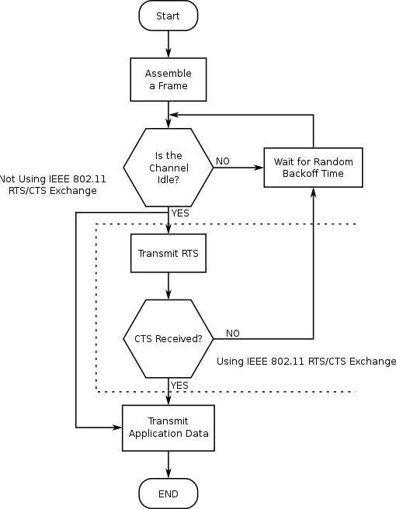
CSMA/CA Procedure
Figure: CSMA/CA procedure

Slide 7
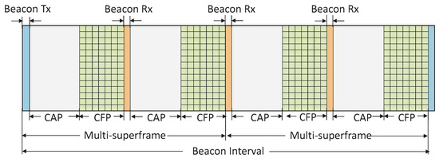
DSME Procedure
Figure: DSME procedure

Slide 8
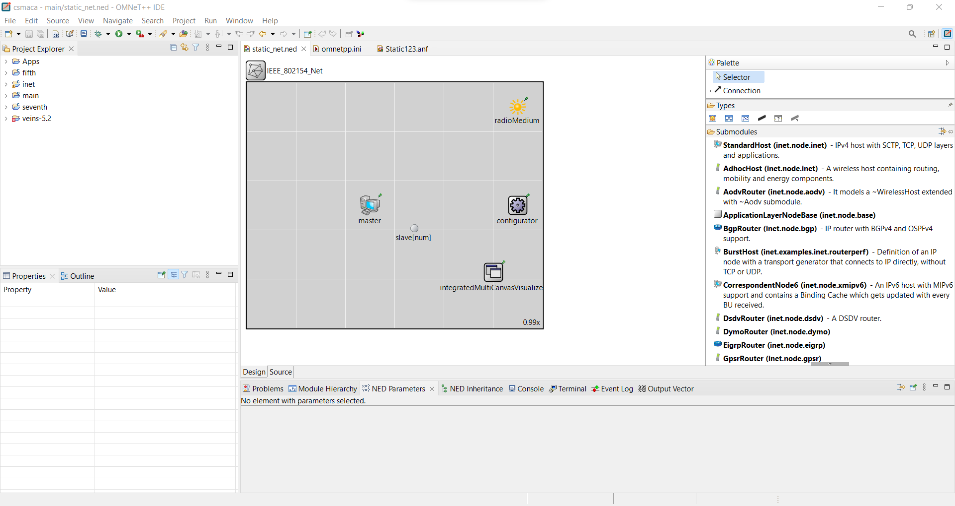
Design of .Ned file

Slide 9
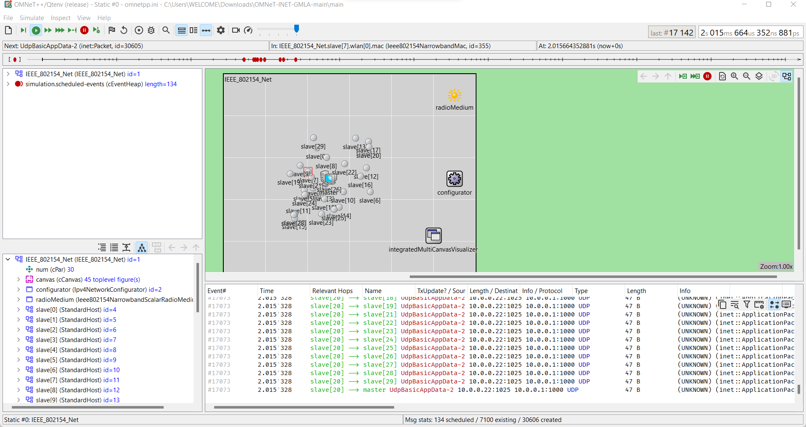
Output

Slide 10
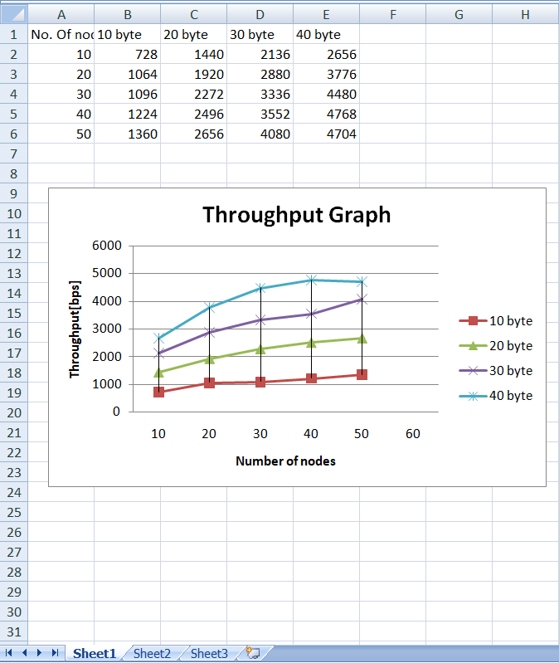
Throughput Graph

Slide 11
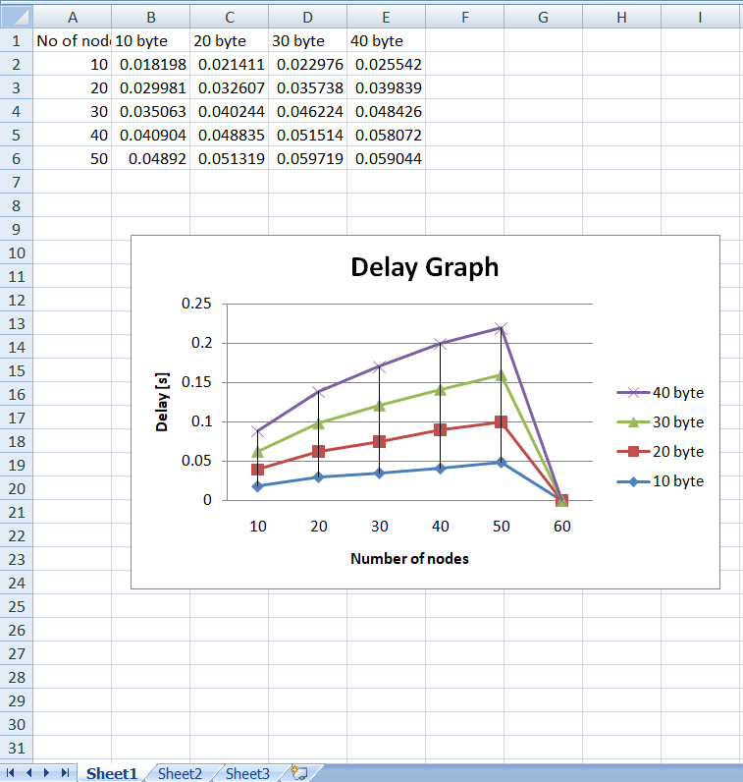
Delay Graph

Slide 12
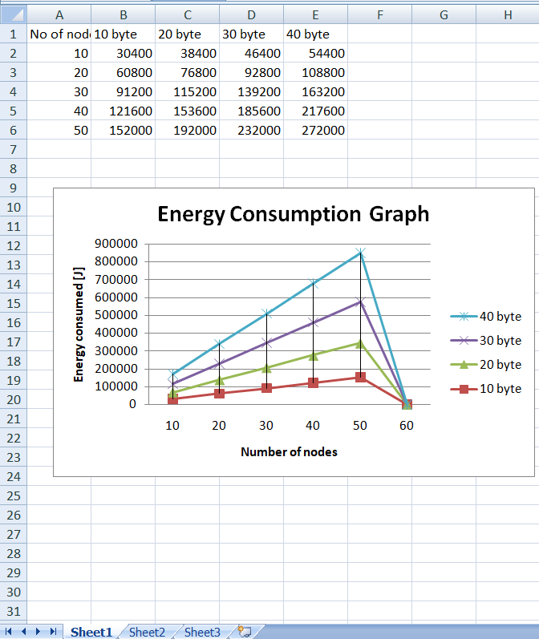
Energy Consumption Graph

Slide 13
Conclusion
The choice of MAC protocol depends on the requirements of the application and the constraints of the network. If the application requires low latency and high responsiveness and the network is relatively small, CSMA/CA can be a good choice. However, if the network is large and requires reliable and collision-free communication, DSME may be a better choice.

Slide 14
Reference
Raza, S., Kulkarni, P., & Voigt, T. (2013). Energy-efficient wireless sensor networks: a survey on existing approaches and open research issues. IEEE Communications Surveys & Tutorials, 15(1), 358-386.
Wang, X., Li, L., Li, Y., & Yu, H. (2017). A survey on MAC protocols for wireless sensor networks. Computer Communications, 109, 36-50.
Al-Fuqaha, A., Guizani, M., Mohammadi, M., Aledhari, M., & Ayyash, M. (2015). Internet of things: A survey on enabling technologies, protocols, and applications. IEEE Communications Surveys & Tutorials, 17(4), 2347-2376.
Montenegro, G., Kushalnagar, N., Hui, J., & Culler, D. (2013). Transmission of IPv6 packets over IEEE 802.15. 4 networks. RFC 6550.
IEEE Standard for Low-Rate Wireless Networks, IEEE 802.15. 4-2015.
Österlind, F., Dunkels, A., & Eriksson, J. (2006). Cross-layer optimization of packet retries for energy-efficient wireless sensor networks. ACM Transactions on Sensor Networks (TOSN), 2(3), 371-384.
Gao, X., Huang, Y., & Qian, Y. (2015). A survey of deterministic and probabilistic medium access control protocols for wireless sensor networks. Journal of Network and Computer Applications, 50, 126-139.

Slide 15
Thank You

